Slide 1
FIRELINE

Slide 2
TABLE OF CONTENTS
01
02
03
Our team
Stages of realization
Used technologies

Slide 3
01
OUR TEAM

Slide 4
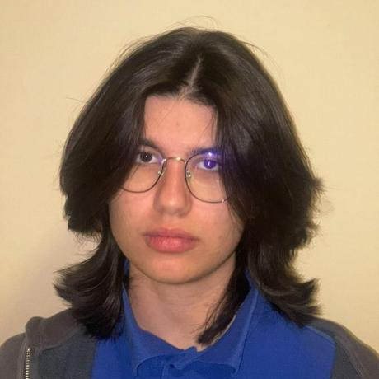
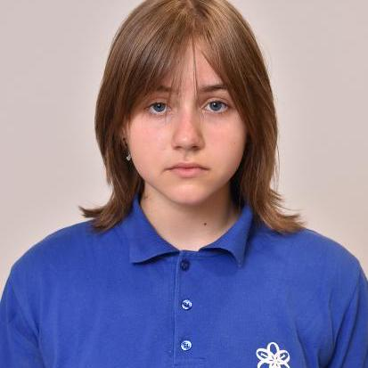
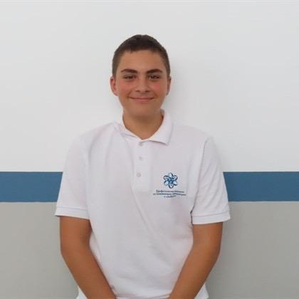
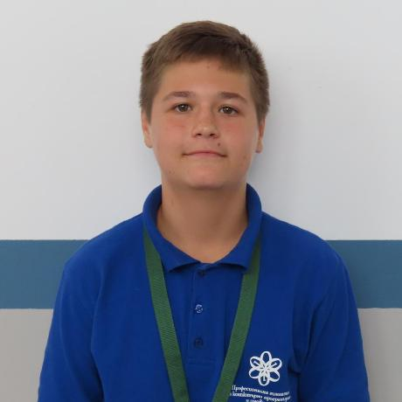
Our team
Roberta Hristova
Amelia dorosh
Scrum Trainer
Designer
Konstantin turmanov
Daniil moldovanov
Backend Developer
Frontend Developer

Slide 5
02
Stages of realization

Slide 6

Stages of realization
We started by brainstorming the concept and assigning team roles to plan the structure of our emergency incident tracking system. Then we designed and developed the website using HTML, CSS, JavaScript, and PHP, creating pages like maps, statistics, and incident reports. Finally, we tested the functionality, improved the user experience, and prepared documentation and a presentation.

Slide 7
03
Used technologies

Slide 8










Program and laguages we used

Slide 9
Let’s see our application

